Slide 1

AAYU
--Unveiling Nature's Healing Secrets--

Slide 2
Ministry/ Organization Name/ Student Innovation: AYUSH
PS Code: 1343
Problem Statement Title: Identification of Different Medicinal Plants/Raw materials through Image Processing Using Machine Learning Algorithms
Team Name: Celestial Coders
Team Leader Name: Ankit Kumar
Institute Code (AISHE): 2546
Institute Name: Maharaja Surajmal Institute of Technology
Theme Name: Project Green

Slide 3
Patient Percentage That Use Medicinal Plants To Treat Diseases
3-5%
80%
85%
Developed Countries
Rural Population
Southern Sahara

Slide 4


Stakeholders
India, with a rich heritage of floral diversity, is well-known for its medicinal plant wealth, but their identification is one of the major burning issues in Ayurvedic Pharmaceutics.
Herbalists
Pharmaceutical Companies
Consumers
Researchers

Slide 5
EPS Analysis
Existing Solution
Solution
E
S
Problem
P
Fortunately, recent advancements in technology have opened up new possibilities. Machine learning algorithms, Coupled with image processing, offer a promising avenue for addressing these challenge.
Imagine, having the ability to identify medicinal plants instantly using mobile apps or hand held devices. This technology has the potential to make identification accessible to both experts and non experts.
Botanists have long identified various species of medicinal plants using traditional and experience-based methods. Nevertheless, visually and manually identifying medicinal plants from other similar plants can be extremely challenging and time-consuming for inexperienced people.
Many counterfeit, low-quality, damaged, or not perfectly preserved medicinal plants are being manufactured and distributed worldwide, which may harm their users.

Slide 6
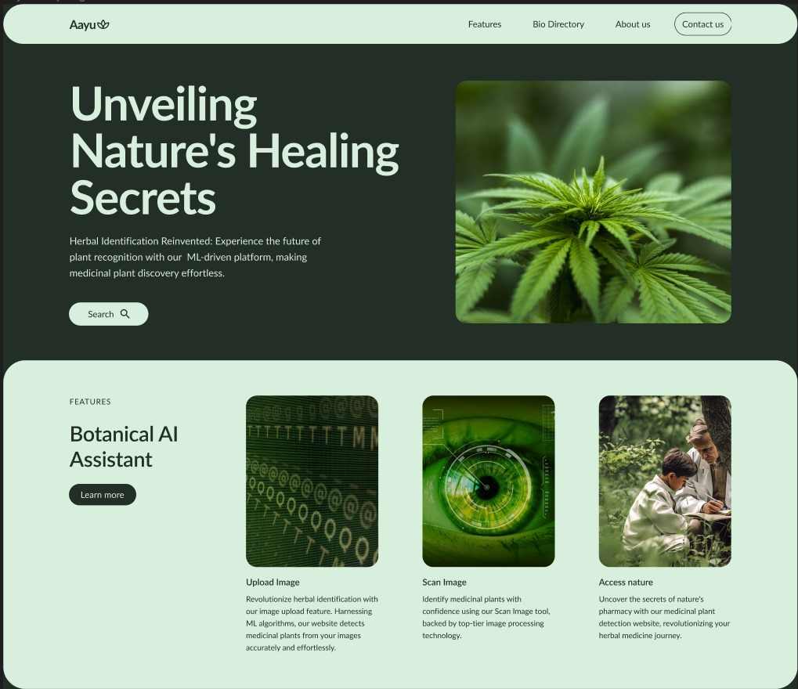
Prototype

Slide 7

Prototype

Slide 8
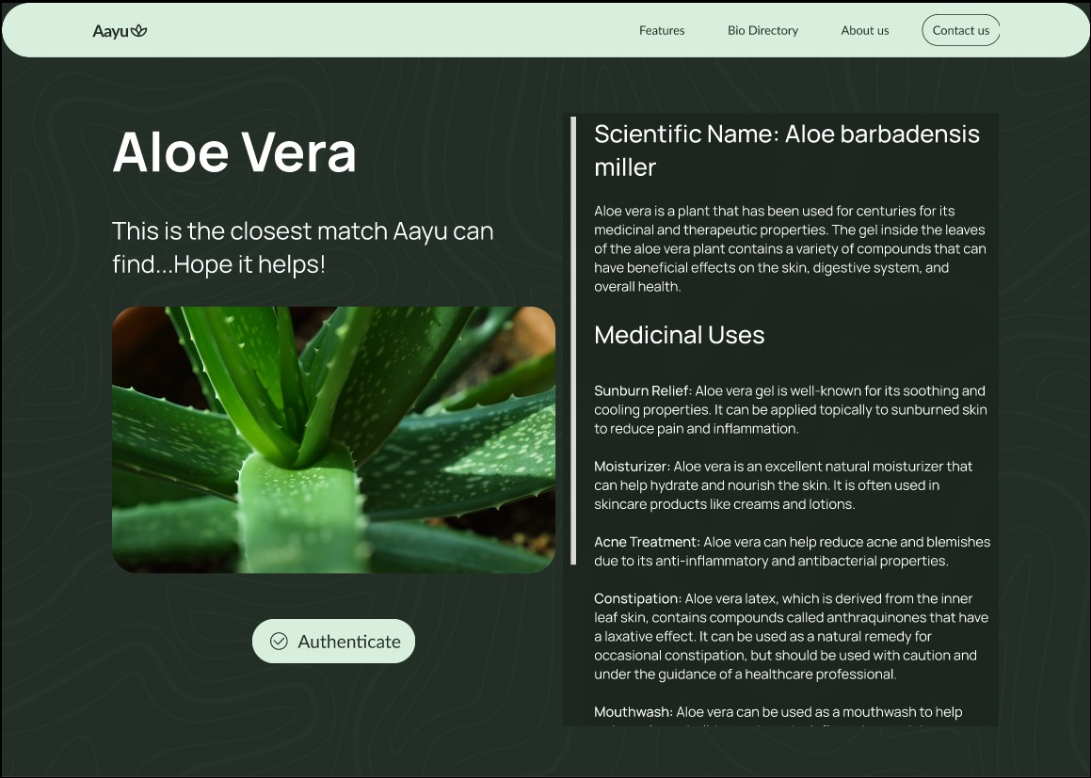
Prototype

Slide 9
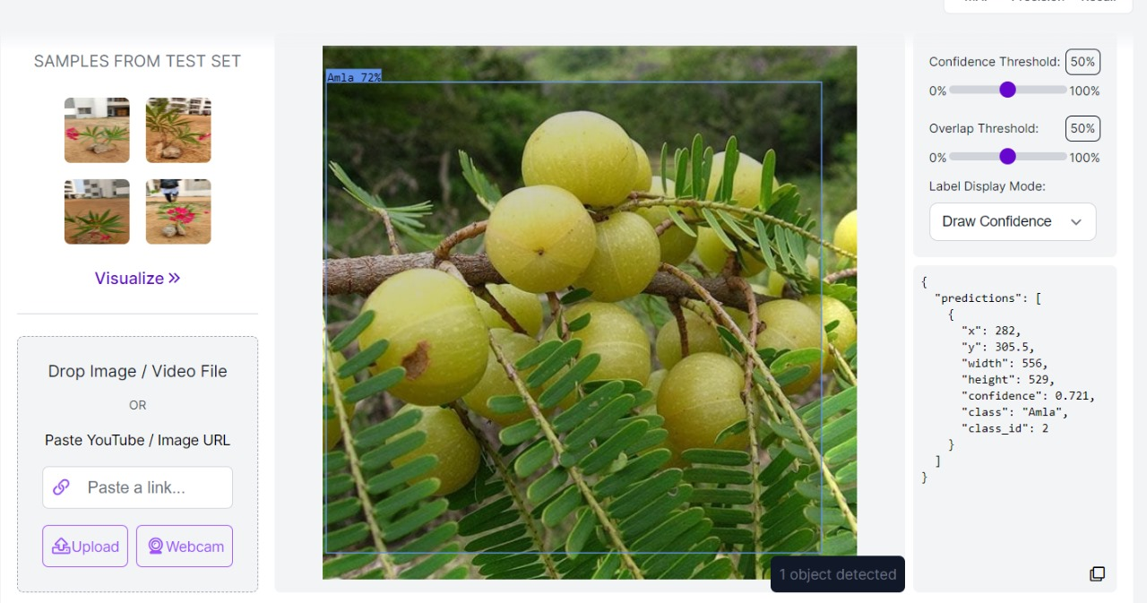
Image Processing

Slide 10
Accuracy
However, with this growth comes a significant challenge – the accurate identification of medicinal plants. This is essential to ensure product safety, efficacy, and authenticity. Misidentification can lead to health risks and economic losses.
One key area for improvement lies in enhancing the accuracy of identification. Machine learning algorithms can be trained to recognize intricate features that may elude the human eye. This can significantly reduce misidentification rates.
YOLOv8 model
Feature Extraction

Slide 11
Ankit Kumar
CSE 2nd year
Anoushka Gupta
CSE 2nd year
Premjeet Singh
CSE 2nd year
Vaidehi Singh
CSE 2nd year
Vikas
CSE 2nd year
Diya Monga
IT 2nd Year

